Slide 1
Data Analysis Logistic Regression
Higher School of Economics, 2020
Author: Alisa Melikyan, PhD, senior lecturer of the School of Software Engineering

Slide 2
Multinomial logistic regression
Multinomial logistic regression is used to model nominal outcome variables. The analysis breaks the outcome variable down into a series of comparisons between two categories.
If we have three outcome categories (A, B and C), then the analysis will consist of two comparisons. The form that these comparisons take depends on how we have selected a baseline category. The important parts of the analysis and output are much the same as binary logistic regression.
We will calculate the probability that the case belongs to each of the groups, that are formed based on the values of dependent variable. We will predict that according to the model a case belongs to the group with maximum probability.

Slide 3
Preliminary Data Analysis
Frequency and contingency tables could help to reveal the completeness of information representation in the dataset and identify some trends and relationships.

Slide 4
Interpreting Results (1)
Gender : 0 – male ,1 – female
Dependent variable has 3 values: Breakfast bar, Oatmeal, Cereal .
How the gender influences the breakfast choice?
(-,147) – males compared to females are less likely to go for Breakfast bar rather than Cereal.
Positive B coefficient indicates that as the predictor increases the chance to be in the current category increases.

Slide 5
Interpreting Results (2)
RRR (relative risk ratio) is an analogue of the odds ratio for Binary logistic regression .
Odds for males is about 14% lower than odds for females to get Breakfast Bar instead of Cereal.

Slide 6
Interpreting Results (3)
Coef (B) | RRR=exp(b) | Interpretation
> 0 | > 1 | Males compared to females (reference group) are more likely to be in the current group than in the reference group. Exp(b)=1,6 -> odds for males is 60% higher than odds for females
= 0 | = 1 | Males and females are equally likely to be in the current and the reference groups.
< 0 | from 0 to 1 | Males compared to females (reference group) are less likely to be in the current group than in the reference group. Exp(b)=0,6 -> Odds for males is 40% lower than odds for females

Slide 7
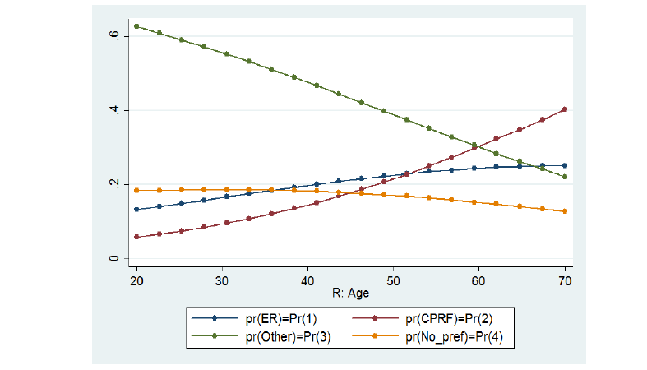
Graphical representation

Slide 8
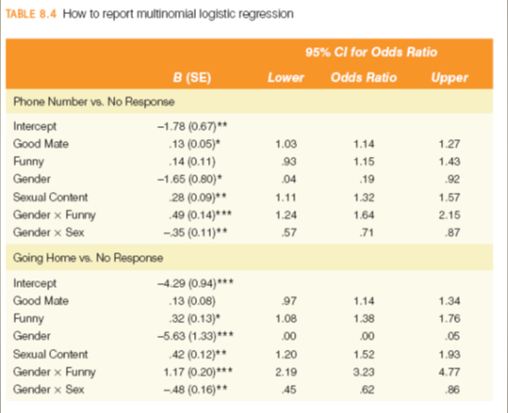
Reporting the Results

Slide 9
Stata Commands
Multinomial logistic regression model
mlogit depvar predictor1 predictor 2 … , base(2)
mlogit depvar predictor1 predictor 2, rrr
Saving probabilities for each case: predict prob*
Column with the maximum probability: egen pred_max = rowmax(prob*)
Predicting group:
g pred_choice = .
forv i=1/3 {
replace pred_choice = `i' if (pred_max == prob`i')
}
Confusion Matrix
. local polit_lab: value label polit
. label values pred_choice `polit_lab'
. tab pred_choice polit, row

Slide 10
Ordinal regression
Ordinal regression is used to model ordinal outcome variables. With can rank the values of the ordinal variable, but the real distance between categories is unknown.
Instead of considering the probability of an individual event, we consider the probability of that event and all events that are ordered before it.

Slide 11
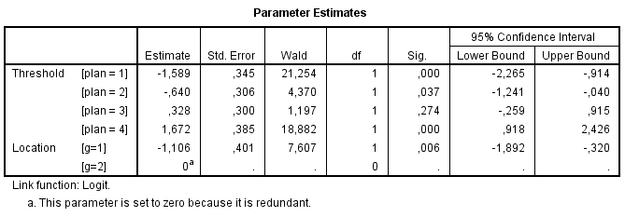
Interpreting the results
Predictor is gender: 1 – male, 2 – female (reference group). As the coefficient is negative (-1,106), males are less likely to get higher results than females.

Slide 12
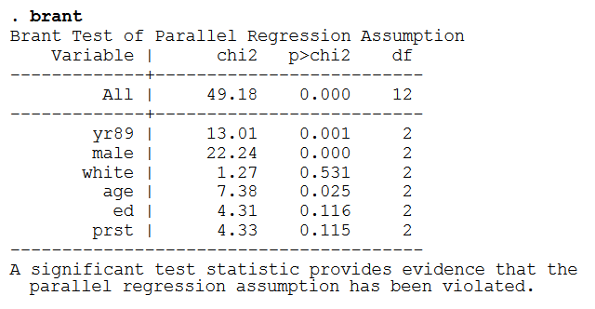
Testing Parallel Lines
When you fit an ordinal regression you assume that the relationships between the independent variables and the logits are the same for all the logits. That means that the results are a set of parallel lines or planes—one for each category of the outcome variable. You can check this assumption by allowing the coefficients to vary, estimating them, and then testing whether they are all equal.

Slide 13
Stata Commands
Ordinal regression model
ologit depvar predictor1 predictor 2
ologit depvar predictor1 predictor 2, or
Saving probabilities for each case: predict prob*
Column with the maximum probability: egen pred_max = rowmax(prob*)
Predicting group:
g pred_choice = .
forv i=1/3 {
replace pred_choice = `i' if (pred_max == prob`i')
}
Confusion Matrix
. local polit_lab: value label polit
. label values pred_choice `polit_lab'
. tab pred_choice polit, row

Slide 14
Useful Links
Multinomial Regression
https://stats.idre.ucla.edu/spss/dae/multinomial-logistic-regression/
https://stats.idre.ucla.edu/spss/output/multinomial-logistic-regression/
http://www.int-arch-photogramm-remote-sens-spatial-inf-sci.net/XL-8/193/2014/isprsarchives-XL-8-193-2014.pdf
http://www.ijmsi.org/Papers/Volume.2.Issue.5/Version-2/A02520108.pdf
https://www.stata.com/manuals13/rmlogit.pdf
Ordinal Regression
http://www.restore.ac.uk/srme/www/fac/soc/wie/research-new/srme/modules/mod5/index.html
https://stats.idre.ucla.edu/spss/dae/ordinal-logistic-regression/
www.norusis.com/pdf/ASPC_v13.pdf
https://stats.idre.ucla.edu/stata/dae/ordered-logistic-regression/
https://www.stata.com/meeting/germany08/GSUG2008-Handout.pdf
https://www.stata.com/meeting/germany08/GSUG2008.pdf

